Slide 1

Web Search Engine COMP8547 – Advanced Computing Concepts Final Project
Instructor: Dr. Mahdi Firoozjaei
Team Members:
Hetsi Gandhi (110122118)
Mahima Rashmi (110122783)
Manjunath Reddy. C (110095281)
Malharsinhg Thakur (110123181)
Dhaval Trivedi (110123934)

Slide 2
Contributors
Hetsi (Ternary search tries & Hashing)
Mahima Rashmi (Spell Check)
Manju (Conversion of Webpages)
Malharsingh Thakur (Web Crawler)
Dhaval Trivedi (Edit distance)

Slide 3
Topics to be discussed
Introduction
Structure
Concept & Practice
Demo
Conclusion

Slide 4
Introduction

Slide 5
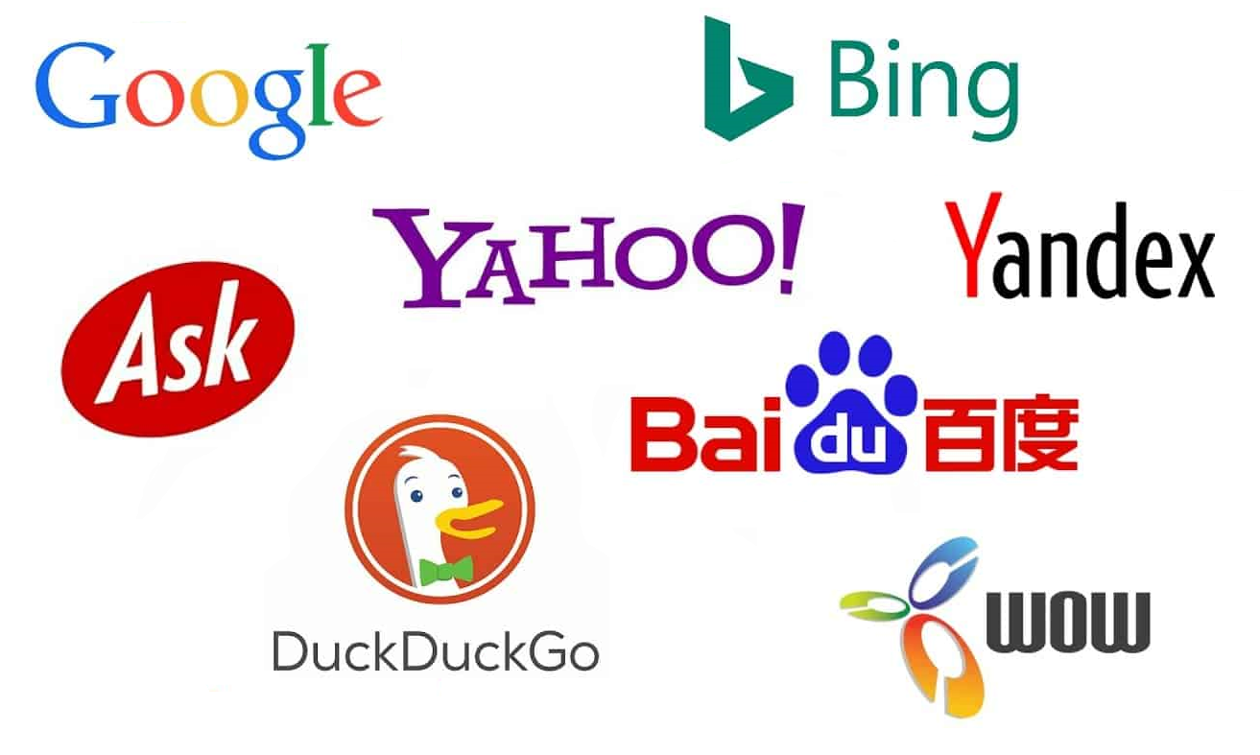
What is web search engine?
A retrieval technology
Retrieve information from the Internet
Feed information back to users
For explanation purpose we have taken data set related to food.

Slide 6

Core Modules
Crawler
Document knowledge base server
Sorting
Link Analysis
Webpage conversion
Webpage anti-spam
Query analysis
Page description/summary

Slide 7
Structure

Slide 8
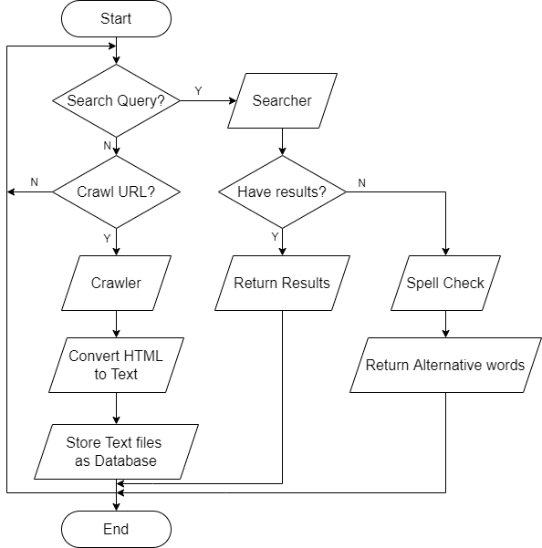
Flow Chart

Slide 9
Concepts & Practice

Slide 10

Crawler
Jsoup
Parsing HTML from a URL, file or string
Using DOM or CSS selectors to find and retrieve data
Operating HTML elements, attributes, and text
Regex (Regular Expression)
Match
Cut
Replace
Get

Slide 11

Search Keywords
Users can search keywords after searching URLs.
Word segmentation
Unpack the string. Break it down into characters. So we can do a keyword search.

Slide 12

Spell Checking
Comparing the user's input word X with existing word Y from source files.
Correct spelling:
There are at least one word Y in the source file which satisfy Y = X.
Incorrect spelling:
Cannot find Y which satisfies Y = X.
Constructing a vocabulary based on all existing .txt files.
Calculating edit distance between X and all words in Vocabulary by substitution, insertion, and deletion.
Sorting words in vocabulary according to edit distance, and selecting top 10 words.

Slide 13
Demo

Slide 14

Conclusion
In this project, Web Crawl, convert HTML to TXT, TXT document preprocessing, Word frequency, Inverted Index and Spell Checker are used. At the same time, we use hashTable, Queue, TST and other data structures as support.
The search engine, is according to the user needs and a certain algorithm, using a specific strategy to retrieve information from the Internet feedback to the user of a search technology.

Slide 15
Thank you

